Slide 1
Online Port for Job Placement and Alumni Management
2014数软软外Java3
胡斯庭Justin
宿金玉 Judy
马宇琪Yolanda
刘赛Savi

Slide 2
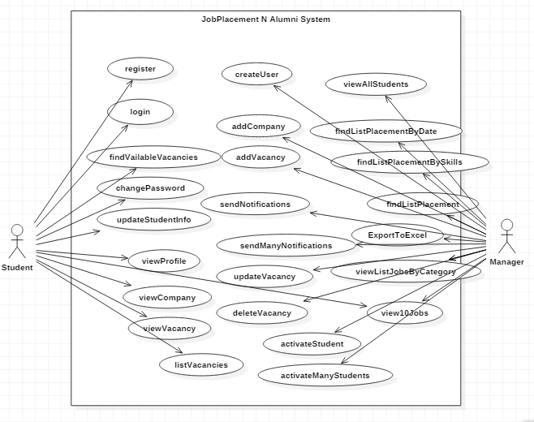
Use Case Diagram

Slide 3
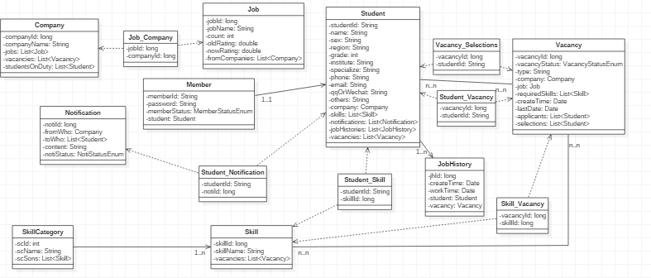
Class Diagram

Slide 4
Class Diagram(Details)
Skills student have
status of the member.
0Inactivated
1Activated
2Manager
notifications
student have

Slide 5
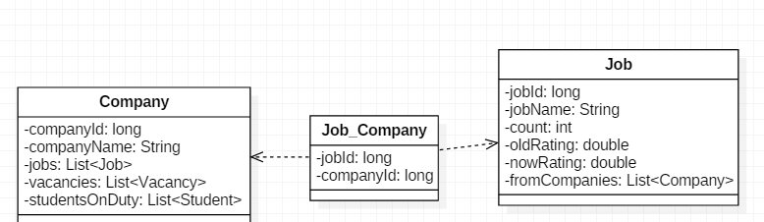
Class Diagram(Details)
many to many
students in the company
companies have the job

Slide 6
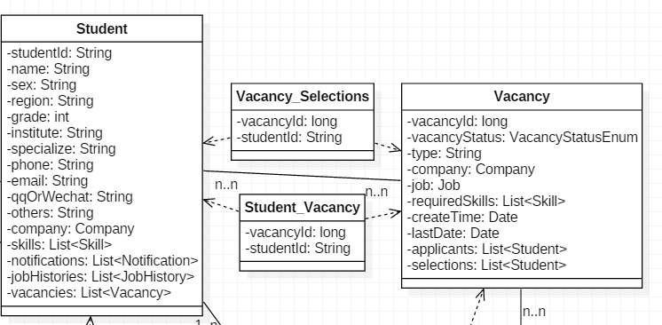
Class Diagram(Details)
many to many

Slide 7
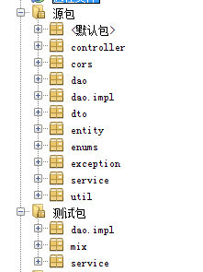
Back End
solve the problem of the cross domain
communicate with front end
kinds of StatusEnum

Slide 8

Library
After Spring MVC,Spring,Hibernate,junit
Should add The DerbyClient and Jackson Jar.

Slide 9
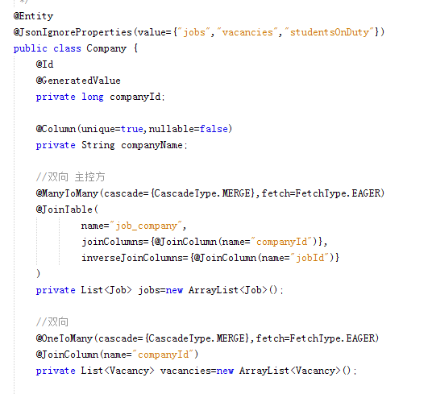
entity
Hibernate helps build the tables with annotations
@JsonIgnoreProperties
helps solve the problem of dead loop while tranfering to JSON
@OneToOne
@OneToMany
@ManyToOne
@ManyToMany
used correctly in every entity

Slide 10
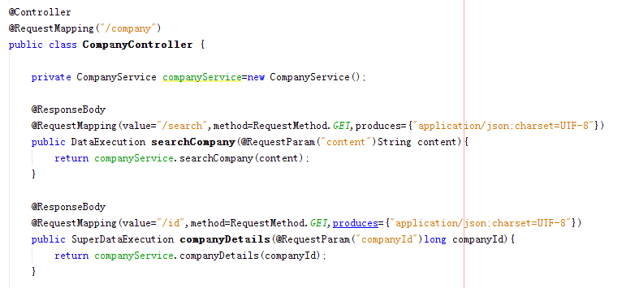
Controller
@ResponseBody for return response with JSON

Slide 11
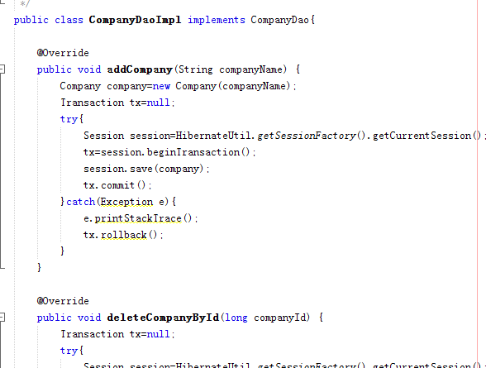
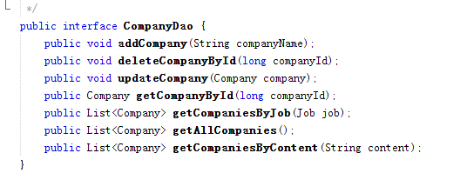
Dao
Dao interface and impl

Slide 12
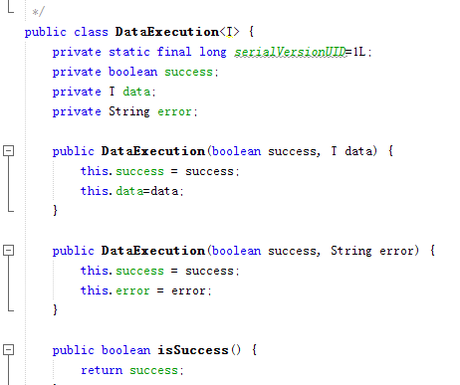
dto
Data Class send to the front end

Slide 13
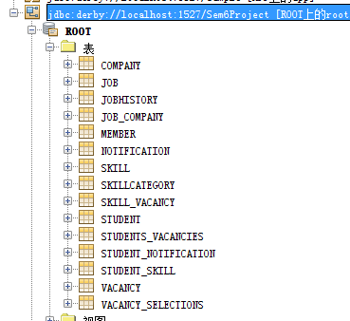
databse
Same as the Class Diagram

Slide 14
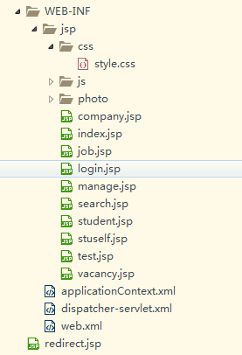
front end
css files
every jsp has its own
js file
Use JQuery,CSS,JQuery-Cookie
jsps
use HBulider to build the front end

Slide 15
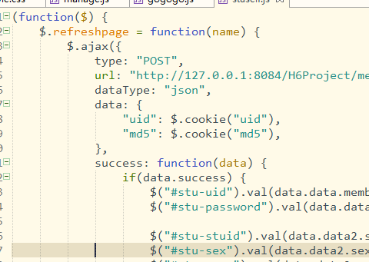
ajax json
need to match the type and url
md5 to encrypt the password irreversiblely

